Slide 1









Funded by the European Union. Views and opinions expressed are however those of the author(s) only and do not necessarily reflect those of the European Union or the European Education and Culture Executive Agency (EACEA). Neither the European Union nor EACEA can be held responsible for them.
Development and Retention of Autistic Staff in Hospitality
Project Number 2023-1-IT01-KA220-VET-000152721
This work is licensed under a Creative Commons Attribution-NonCommercial 4.0 International License. In addition, an acknowledgement of the authors of the document and all applicable portions of the copyright notice must be clearly referenced. All rights reserved.

Slide 2
ABOUT:
PROJECT RESULTS
The ’PERFORM’ project is about educating Hospitality Managers and HR Experts in developing and supporting Autistic Staff in the EU Hospitality Sector. It also delivers an Innovative HR Platform, for performance appraisals and employee monitoring.
1
Project Result 1: PERFORM HR Platform
2
Project Result 2: PERFORM Digital Toolkit
3
Project Result 3: VET Course for Hospitality
Managers and HR Experts
Project Number 2023-1-IT01-KA220-VET-000152721

Slide 3
Module 6 : Using the PERFFORM HR Platform
Module Aim
Learning Outcomes
Module 6 is about helping learners develop the skills needed to effectively use the PERFORM HR Platform, focusing on supporting neurodivergent employees, fostering workplace inclusivity, and improving employee retention and satisfaction through practical tools and data-driven approaches.
Educate learners on effectively navigating and utilizing the PERFORM HR Platform's core tools to support neurodivergent employees.
Educate learners on interpreting platform analytics to identify trends and implement strategies for improving workplace inclusivity and retention.
Educate learners on applying data-driven insights to enhance employee engagement and foster a supportive work environment.
1
2
Elaborate on what you want to discuss.
3
Project Number 2023-1-IT01-KA220-VET-000152721

Slide 4
The PERFORM HR Platform
Platform’s tools
The PERFORM HR Platform is designed to help hospitality organizations manage and support diverse talent, especially neurodivergent employees. It offers tools that assist managers in creating inclusive workplaces and provides HR professionals with resources to foster equity and support for all staff.
1
Employee Evaluation Tool
Personal Diary
Work Enivronmment Assessment Tool
2
3
Elaborate on what you want to discuss.
Project Number 2023-1-IT01-KA220-VET-000152721

Slide 5
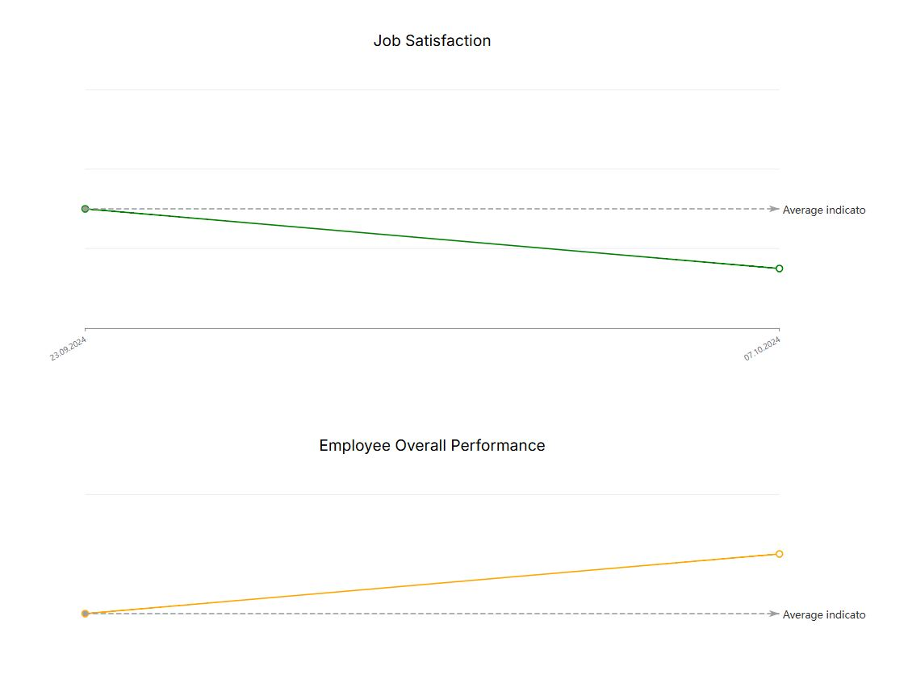
Employee Evaluation Tool
The Employee Evaluation Tool helps managers assess employee performance and satisfaction through a structured survey. Managers evaluate key aspects like job satisfaction, colleague interactions, and overall contributions, then submit their assessments securely. The History feature allows managers to review past evaluations with visual charts comparing employee performance in job satisfaction, overall performance, and interactions, helping track progress and identify trends.
Elaborate on what you want to discuss.
Visual charts highlighting trends in employees’ performance
Project Number 2023-1-IT01-KA220-VET-000152721

Slide 6
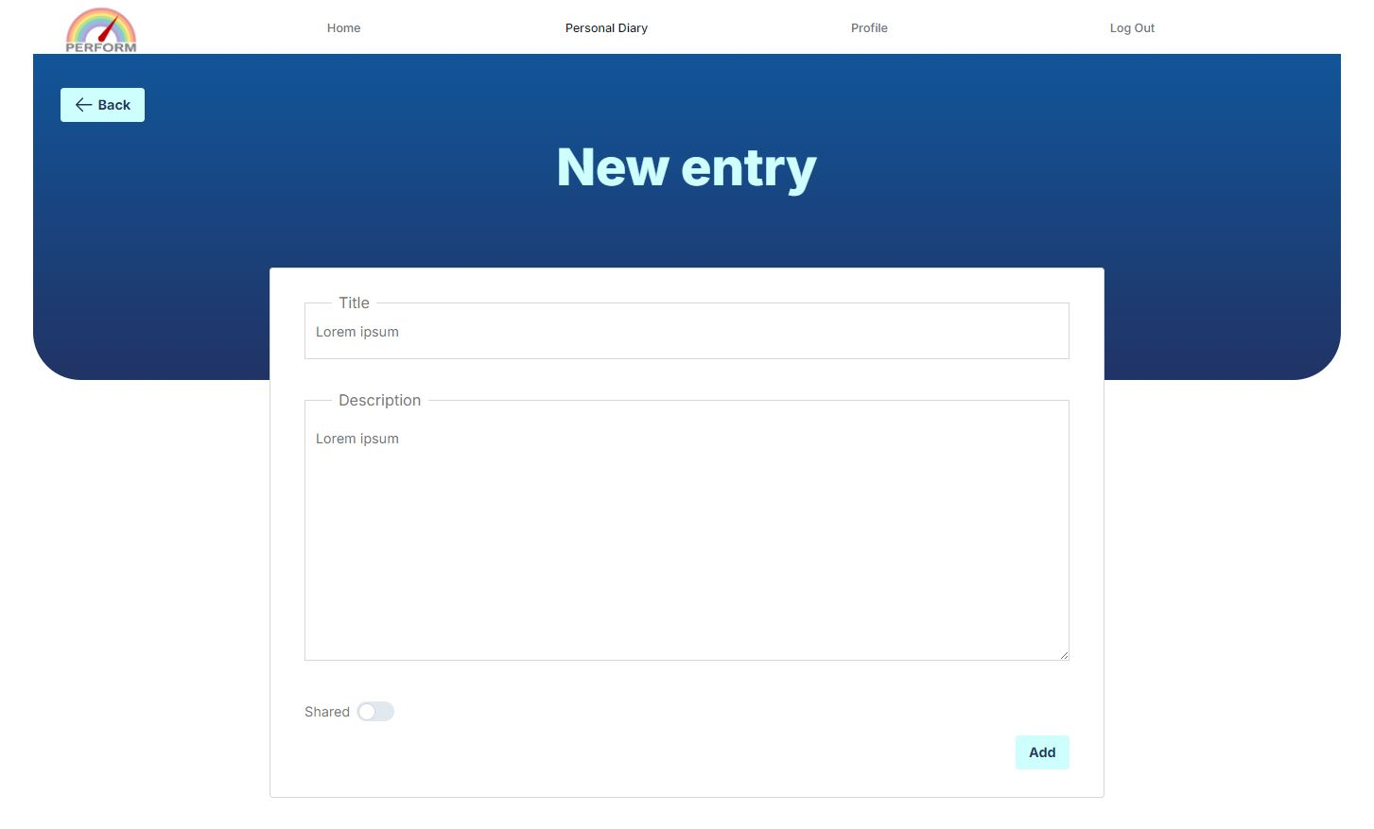
Personal Diary
The Personal Diary tool allows employees to document their daily work experiences, progress, and challenges. Employees can add entries for personal reflection or share them with managers to foster open communication and receive tailored support. This tool promotes self-awareness, growth, and strengthens the relationship between employees and management.
Elaborate on what you want to discuss.
Adding a new entry in the “Personal Diary”
Project Number 2023-1-IT01-KA220-VET-000152721

Slide 7
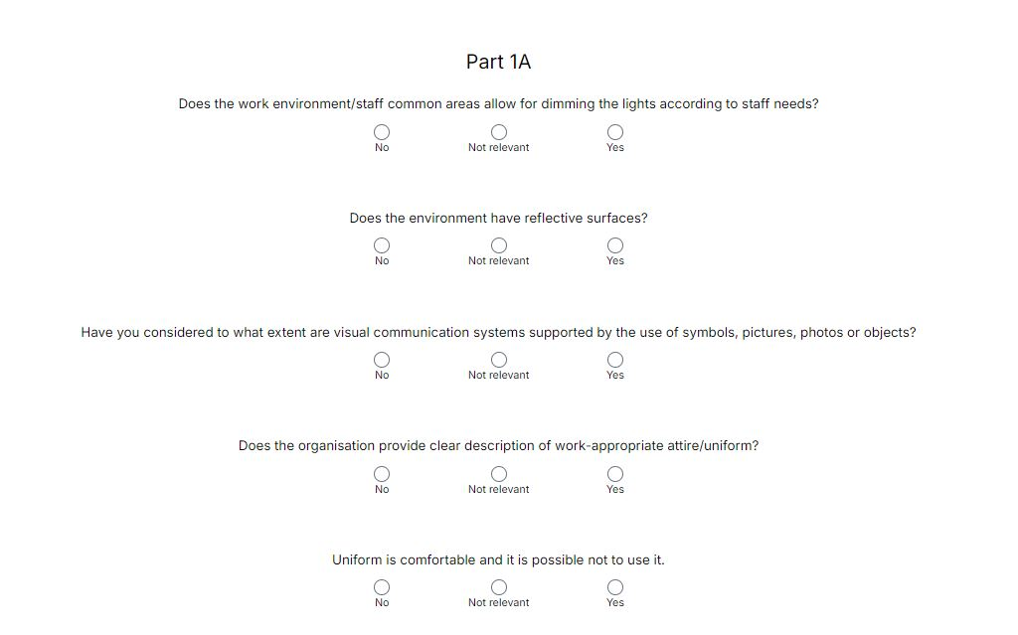
Work Environment Assessment Tool
The Work Environment Assessment tool allows managers to evaluate both the physical and social aspects of the workplace. Managers can complete a structured survey to assess factors like workspace design, safety, and team interactions, with the data stored for analysis. This tool helps ensure consistent reviews and supports improvements to the work environment.
Elaborate on what you want to discuss.
A checklist for evaluating the work environment
Project Number 2023-1-IT01-KA220-VET-000152721

Slide 8
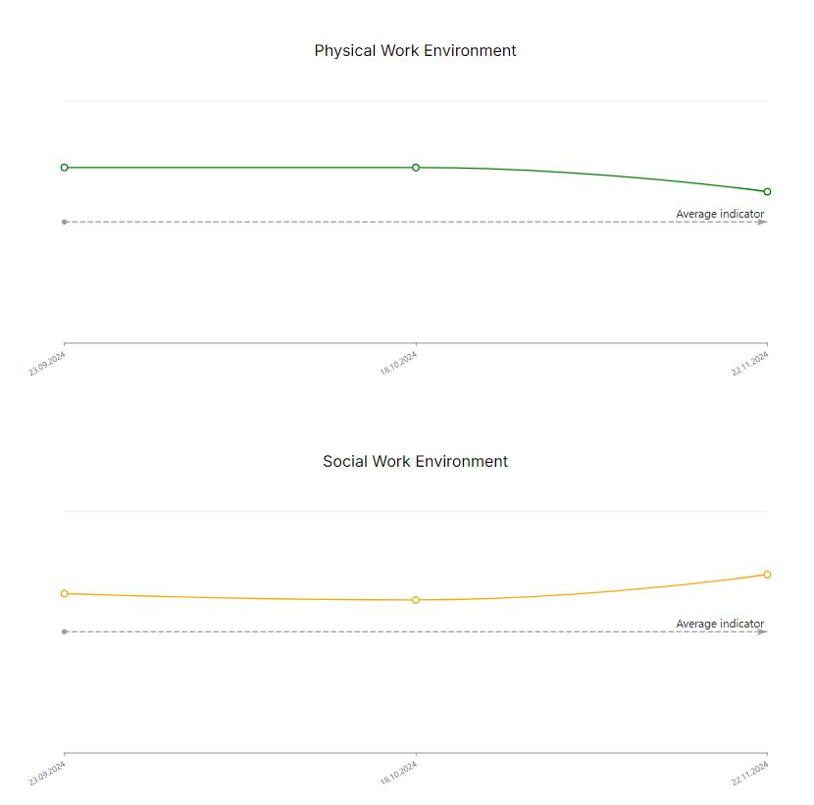
Using analytics for workplace improvement
The PERFORM HR Platform’s analytics offer a data-driven approach to improve workplace practices. Visual charts track trends in job satisfaction, performance, and work environment, helping managers identify areas for action. Analytics also support goal-setting, progress tracking, and personalized plans, especially for neurodivergent employees. By aligning data with KPIs, managers foster an inclusive environment and drive continuous improvement in employee satisfaction and performance, enabling informed decision-making and effective communication.
Elaborate on what you want to discuss.
Visual charts highlighting trends in the work environment
Project Number 2023-1-IT01-KA220-VET-000152721

Slide 9
Funded by the European Union. Views and opinions expressed are however those of the author(s) only and do not necessarily reflect those of the European Union or the European Education and Culture Executive Agency (EACEA). Neither the European Union nor EACEA can be held responsible for them.
THANK YOU
Project Number 2023-1-IT01-KA220-VET-000152721

