Slide 1









Funded by the European Union. Views and opinions expressed are however those of the author(s) only and do not necessarily reflect those of the European Union or the European Education and Culture Executive Agency (EACEA). Neither the European Union nor EACEA can be held responsible for them.
Development and Retention of Autistic Staff in Hospitality
Project Number 2023-1-IT01-KA220-VET-000152721
This work is licensed under a Creative Commons Attribution-NonCommercial 4.0 International License. In addition, an acknowledgement of the authors of the document and all applicable portions of the copyright notice must be clearly referenced. All rights reserved.

Slide 2
ABOUT:
PROJECT RESULTS
The ’PERFORM’ project is about educating Hospitality Managers and HR Experts in developing and supporting Autistic Staff in the EU Hospitality Sector. It also delivers an Innovative HR Platform, for performance appraisals and employee monitoring.
1
Project Result 1: PERFORM HR Platform
2
Project Result 2: PERFORM Digital Toolkit
3
Project Result 3: VET Course for Hospitality
Managers and HR Experts
Project Number 2023-1-IT01-KA220-VET-000152721

Slide 3
Module 3 : Work Environment Management
Module Aim
Learning Outcomes
In order to support the Development and Retention of Autistic Staff, Hospitality Managers and HR Experts need to acquire the knowledge and skills that will enable them to appropriately evaluate and adapt the Work Environment. This module aims to do so.
1
To give the understanding the Definition of an Autism-friendly Work Environment
The Development of Team Management Skills in inclusive workplace
Provide Guidelines for assessing and adapting the Work Environment in an Autism-friendly context
2
3
Elaborate on what you want to discuss.
Project Number 2023-1-IT01-KA220-VET-000152721

Slide 4
Module 3: Module content
1. Defining an Autism Friendly Work Environment
2. Sensory Overload
  Tactile
  Auditory
  Visual
3. Best Practices for Sensory Accomendation
4. Inclusive Management Skills
5. Building inclusive Teams ​
Project Number 2023-1-IT01-KA220-VET-000152721

Slide 5
1. AN AUTISM FRIENDLY WORK ENVIRONMENT
Project Number 2023-1-IT01-KA220-VET-000152721

Slide 6

What is an autism friendly
work environment?
Project Number 2023-1-IT01-KA220-VET-000152721

Slide 7

Physical environment
Social environment
Organizational culture
Project Number 2023-1-IT01-KA220-VET-000152721

Slide 8

Sensory accommodations
Clear communication
Flexibility
Routine
Inclusive culture
Supportive management
Project Number 2023-1-IT01-KA220-VET-000152721

Slide 9

What can the work environment feel like for an individual with autism?
Project Number 2023-1-IT01-KA220-VET-000152721

Slide 10
2. SENSORY
OVERLOAD
Project Number 2023-1-IT01-KA220-VET-000152721

Slide 11

Tactile issues
avoids or is bothered by light touch;
bothered by certain fabrics, textures or clothes;
bothered by tags on clothing;
has an aversion to normal skin-contact interactions, handshakes for example;
gets very upset by minor bruises;
is resistant on wearing protective clothing or using safety aids etc.
Project Number 2023-1-IT01-KA220-VET-000152721

Slide 12

Visual distractions
bothered by bright or fluorescent lights;
bothered by patterns;
trouble reading high-contrast materials (such as black on white);
squint, blink, or rub their eyes frequently.
Project Number 2023-1-IT01-KA220-VET-000152721

Slide 13

Audial distractions
Hypo-responsive (under-responsive)
seeks out noisy situations or specific noises;
makes noise to themselves or make noise “for noise’s sake”;
do not respond to verbal cues (even when called by name);
likes excessively loud music;
seems oblivious to certain sounds;
do not understand or remember things said to them
Project Number 2023-1-IT01-KA220-VET-000152721

Slide 14
Audial distractions
Hyper-responsive (over-responsive) :
is easily distracted by noise;
makes their own noise to drown out other sounds;
dislikes noisy appliances (printers, air conditioners, ventilators, chatting) etc;
notices background noises others don’t seem to hear;
frequently asks people to be quiet—to stop talking or singing.
Project Number 2023-1-IT01-KA220-VET-000152721

Slide 15
3. BEST PRACTICES FOR SENSORY ADJUSTMENTS
Project Number 2023-1-IT01-KA220-VET-000152721

Slide 16

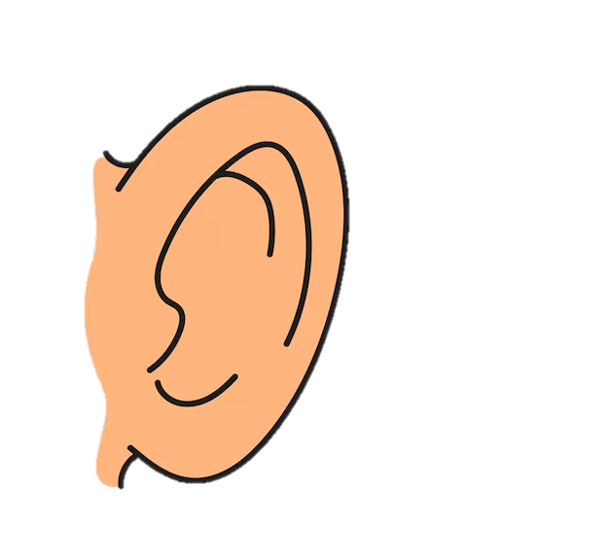

Sound (Auditory)
      Offer noise-cancelling headphones or earplugs
Assign quieter tasks or zones when possible
Minimize background noise in staff areas
Provide written instructions to supplement verbal ones
Light (Visual)
Use soft, adjustable lighting (avoid fluorescent lights)
Install blinds or allow sunglasses/caps
Reduce visual clutter in shared spaces
Provide clear, simple signage
Touch (Tactile)
Allow alternative uniform fabrics
Respect personal space and physical contact preferences
Provide fidget tools or sensory items if helpful
Offer quiet break areas for regulation
Project Number 2023-1-IT01-KA220-VET-000152721

Slide 17
4. INCLUSIVE MANAGEMENT SKILLS
Project Number 2023-1-IT01-KA220-VET-000152721

Slide 18

Supporting Autistic Employees Through Inclusive Leadership
Provide extra structure
Adapt communication styles
Rethink feedback
Assign based on strengths
Respect emotional expression
Reframe social participation
Avoid assumptions
Promote autonomy
Train managers and teams
Project Number 2023-1-IT01-KA220-VET-000152721

Slide 19
5. TEAM MANAGEMENT & BUILDING INCLUSIVE TEAMS
Project Number 2023-1-IT01-KA220-VET-000152721

Slide 20

What makes a team inclusive for autistic people?
What makes a team exclusive for autistic people?
Project Number 2023-1-IT01-KA220-VET-000152721

Slide 21
BULLYING AND ISOLATION
Project Number 2023-1-IT01-KA220-VET-000152721

Slide 22

Training for Inclusion: Why It Works
Inclusion is not just policy—it’s mindset and behavior.
Education helps coworkers understand autism and avoid misunderstandings.
It reduces stigma and builds empathy toward different behaviors.
Project Number 2023-1-IT01-KA220-VET-000152721

Slide 23

Team building activities
Avoid or make alternatives to activities that are…
❌ Loud, high-sensory environments (e.g. crowded parties, bars, or noisy venues)
❌ Unstructured social events
❌ Mandatory participation in group games involving touch, improvisation, or fast-paced talkin
❌ Activities focused on small talk or networking (e.g. speed networking or “get to know you” mingling)
❌ Alcohol-centered events
(e.g. pub crawls or cocktail hours)
Project Number 2023-1-IT01-KA220-VET-000152721

Slide 24
Team building activities
Instead, offer structured, calm, and optional alternatives like…
Icebreaker activities​
Collaborative problem-solving activities​
Group brainstorming sessions​
Team-building games​
Social events or parties can involve e.g. escape rooms, alcohol free lunches, interest-based workshops, quiet areas
Project Number 2023-1-IT01-KA220-VET-000152721

Slide 25
10 Steps to manage an Inclusive Team
1. Educate the team about autism regularly
2. Set clear communication guidelines (avoid sarcasm, use written follow-up)
3. Establish consistent expectations and routines
4. Foster a culture of mutual respect and curiosity
5. Provide structured, low-pressure social interaction
6. Train managers in inclusive leadership techniques
7. Encourage open, non-judgmental communication
8. Be flexible in how work gets done
9. Evaluate and adjust practices regularly
10. Partner with autism organizations for support and guidance
Project Number 2023-1-IT01-KA220-VET-000152721

Slide 26
Funded by the European Union. Views and opinions expressed are however those of the author(s) only and do not necessarily reflect those of the European Union or the European Education and Culture Executive Agency (EACEA). Neither the European Union nor EACEA can be held responsible for them.
THANK YOU
Project Number 2023-1-IT01-KA220-VET-000152721

