Slide 1









Funded by the European Union. Views and opinions expressed are however those of the author(s) only and do not necessarily reflect those of the European Union or the European Education and Culture Executive Agency (EACEA). Neither the European Union nor EACEA can be held responsible for them.
Development and Retention of Autistic Staff in Hospitality
Project Number 2023-1-IT01-KA220-VET-000152721
This work is licensed under a Creative Commons Attribution-NonCommercial 4.0 International License. In addition, an acknowledgement of the authors of the document and all applicable portions of the copyright notice must be clearly referenced. All rights reserved.

Slide 2
ABOUT:
PROJECT RESULTS
The ’PERFORM’ project is about educating Hospitality Managers and HR Experts in developing and supporting Autistic Staff in the EU Hospitality Sector. It also delivers an Innovative HR Platform, for performance appraisals and employee monitoring.
1
Project Result 1: PERFORM HR Platform
2
Project Result 2: PERFORM Digital Toolkit
3
Project Result 3: VET Course for Hospitality
Managers and HR Experts
Project Number 2023-1-IT01-KA220-VET-000152721

Slide 3
Module 1 : Autism in the European Hospitality Sector and
Social Policies
Module Aim
Learning Outcomes
Module 1 aims to introduce learners to Social Policies and their impact on the EU Hospitality Sector, provide general information about autism, and explain how autistic staff can be included in such organisations.
1
Introduce learners to the concept of Social Responsibility Policies and its impact and value in the Hospitality sector
Understand the concept of Inclusive Employment and its primary definition
Understand the definition of the Autism
Spectrum and its general characteristics, focusing on the value, advantages and challenges of employing
2
3
Elaborate on what you want to discuss.
Project Number 2023-1-IT01-KA220-VET-000152721

Slide 4
Background
Global Context
Neurodiversity
People with disabilities represent approximately 15% of the global population, with 785-975 million being of working age. Fewer than 10% of individuals on the autism spectrum are in paid employment, compared to 45% of people with other disabilities.
"Neurodivergent" describes individuals whose selective neurocognitive functions fall outside prevalent societal norms. Autism spectrum disorder (ASD) affects approximately one in 100 children worldwide.
Employment Barriers
Autistic individuals frequently encounter barriers due to systemic and social factors. Challenges related to communication, sensory processing, and social expectations can make traditional hiring and work environments inaccessible.

Slide 5
The Value of Neurodiversity in Hospitality
Business Benefits
Societal Impact
Strategic Advantage
In tourism and hospitality—sectors that thrive on diversity, personalisation, and human connection—embracing neurodiversity is not only ethical but practical. With proper support, autistic professionals bring strong assets such as attention to detail, reliability, creative problem-solving, and customer care consistency.
Employing autistic individuals benefits broader society by promoting independence, enhancing well-being, and enabling individuals to contribute economically and socially, including through taxation and civic participation.
Inclusive employment should not be viewed solely as an act of Corporate Social Responsibility (CSR) but as an investment in talent and innovation, building genuinely diverse and high-performing teams.

Slide 6
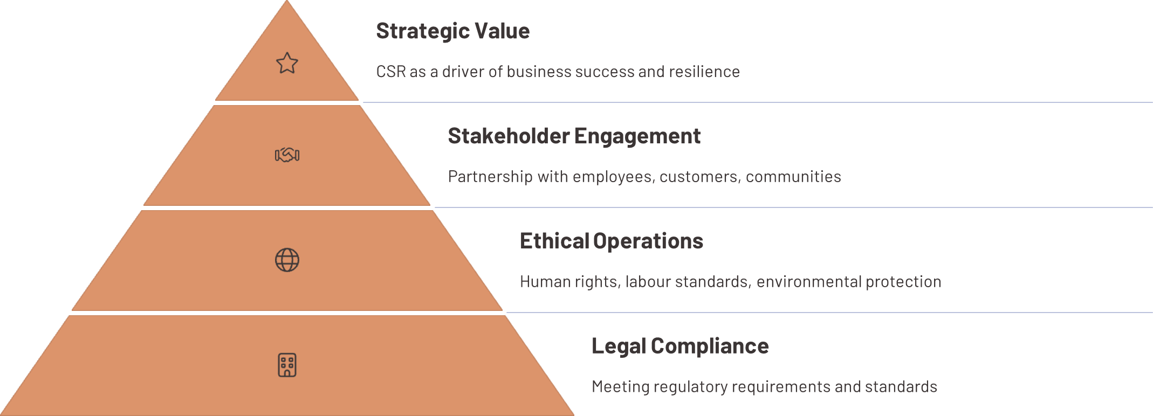
Corporate Social Responsibility (CSR):
Core Concepts
Corporate Social Responsibility represents a company's commitment to operating in ways that enhance societal well-being while minimising negative impacts on people and the planet.
Today, businesses' role extends far beyond creating jobs and delivering goods and services—it includes responsibilities related to human rights, labour conditions, public health, and inclusive development.

Slide 7
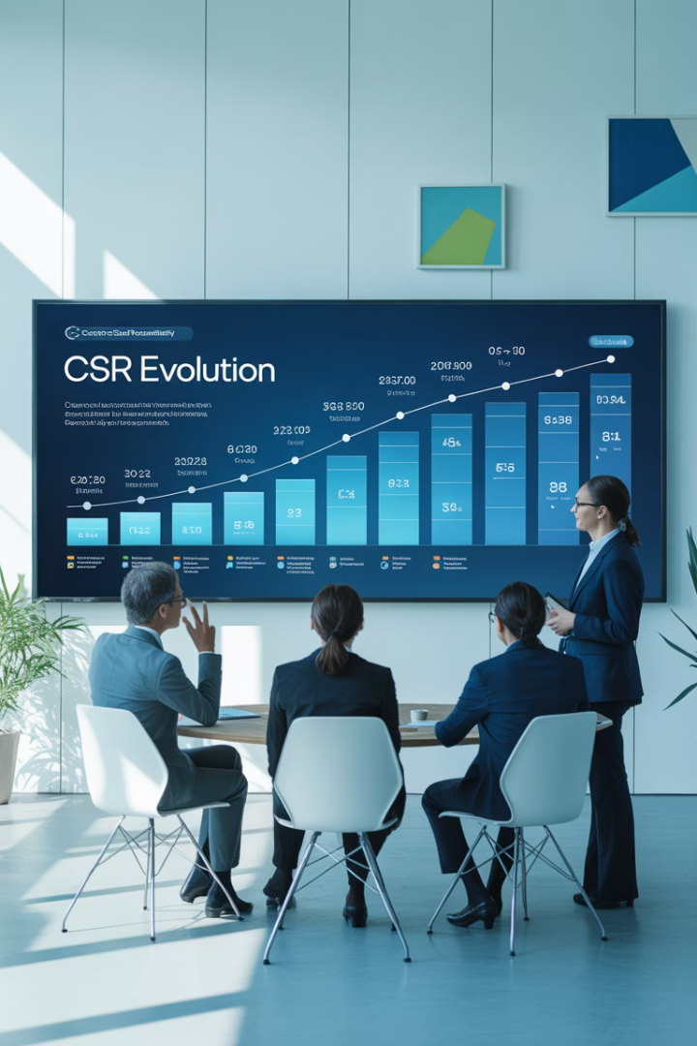
Evolution of CSR Thinking
1
Early Foundations (1812)
Robert Owen introduced a socially conscious business model focused on community welfare.
2
Modern Framework (1960-1979)
Scholars like Keith Davis and Archie Carroll framed CSR as layered responsibilities: economic, legal, ethical, and philanthropic.
3
Strategic Integration (1990s-2000s)
Carroll's CSR Pyramid and Schwartz & Carroll's Three-Domain Model integrated ethical, legal, and economic imperatives.
4
Shared Value (2007-Present)
Porter and Kramer advocated pursuing shared value, aligning social progress with business success.

Slide 8
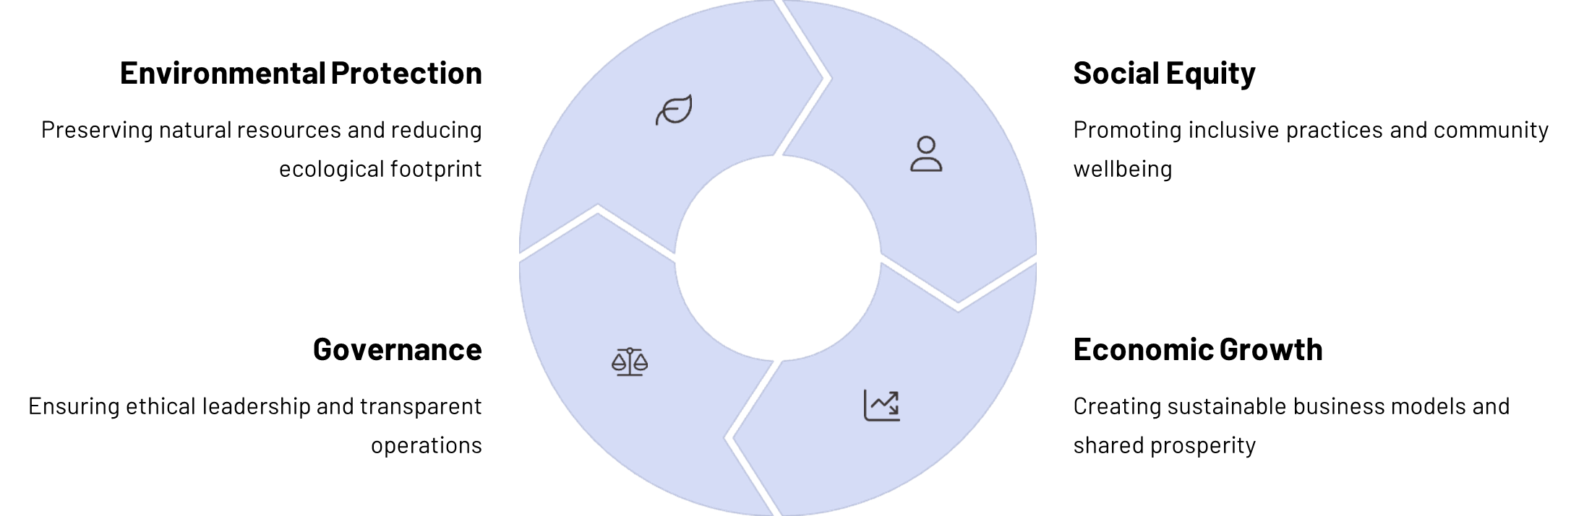
CSR and Sustainable Development
CSR is deeply integrated with sustainable development, as defined by the Brundtland Report: "meeting the needs of the present without compromising the ability of future generations to meet their own needs." The United Nations' Agenda 2030 and its 17 Sustainable Development Goals provide a universal framework for businesses to contribute to social equity, environmental protection, and economic growth.

Slide 9
CSR Value in Tourism and Hospitality
Strategic Advantage
Trust Building
Long-term Vision
CSR has evolved from a moral imperative to a key factor in a firm's strategy and success, particularly relevant in tourism and hospitality where businesses operate at the intersection of service, culture, and community engagement.
CSR is vital in restoring consumer trust, especially in a post-crisis era when transparency and ethical conduct are in high demand. Today's travellers are more likely to choose businesses aligning with their values.
To create shared value, hospitality businesses must move beyond one-off social initiatives and embrace a long-term, strategic CSR vision that contributes meaningfully to social cohesion and inclusive economic growth.

Slide 10




CSR Impact in Tourism and Hospitality
Talent Attraction & Retention
Helps attract and retain skilled talent, boosting motivation and productivity within the organisation.
Enhanced Resilience
Enables businesses to better manage risks and navigate crisis scenarios.
Stakeholder Engagement
Competitive Advantage
Encourages the engagement of customers, partners, suppliers, and investors motivated by social causes.
Improves public image and reputation, creating new market opportunities through higher levels of trust.

Slide 11


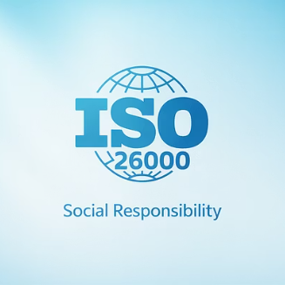


International CSR Frameworks
When implementing CSR, organisations can rely on several international frameworks. The UN's 2030 Agenda sets 17 Sustainable Development Goals as a universal roadmap. The UN Global Compact focuses on human rights, labour standards, environmental protection, and anti-corruption. ISO 26000 outlines core areas of social responsibility, while the OECD Guidelines promote responsible business conduct.
Additional frameworks include B Corp Certification, SA8000 for workplace conditions, the EU's Eco-Management and Audit Scheme (EMAS), and the UNWTO Global Code of Ethics for Tourism.

Slide 12

The Agenda 2030 and Sustainable Development Goals (SDGs)
Adopted by the United Nations in September 2015, the 2030 Agenda for Sustainable Development represents a crucial global framework guiding policies and actions towards a more sustainable future. Built on the three pillars of environmental, economic, and social sustainability, it emphasizes their interconnections, placing them on an equal footing (United Nations, n.d.).
The EU has actively contributed to defining the Agenda and remains fully committed to its implementation, embedding the Sustainable Development Goals (SDGs) within its policy framework and the European Commission's priorities (European Commission, n.d.). The Agenda's holistic and integrated approach is considered essential to addressing global challenges such as climate change, inequality, and social cohesion.
The SDGs are intrinsically linked to social sustainability. Goals such as poverty reduction (SDG 1), health and well-being (SDG 3), quality education (SDG 4), gender equality (SDG 5), and decent work (SDG 8) directly reflect social dimensions of sustainability. Consequently, the measurement of social impact has become a fundamental tool for aligning strategies of international organizations, governments, and enterprises with sustainable development objectives (McGuinn et al., 2020).

Slide 13
CSR Implementation Methodology
Stakeholder Engagement
Involve management and staff actively. Identify key stakeholders (employees, guests, suppliers, communities) and understand which social and environmental issues matter most to them through surveys and consultations.
Strategic Alignment
Align CSR efforts with the organisation's mission, vision, and values. Review existing initiatives to shape a practical CSR plan that supports business objectives while creating social value.
Implementation & Measurement
Share the strategy with stakeholders to ensure alignment and support. Implement gradually and review regularly using reliable indicators from frameworks like the Global Reporting Initiative to measure impact effectively.

Slide 14
EU CSR Policy Development
2001-2002
1
Publication of the Green Paper and Communication from the European Commission, promoting voluntary CSR adoption as part of a broader strategy for sustainable development.
2
2011
Introduction of a renewed CSR strategy aligning with global frameworks such as the UN Guiding Principles on Business and Human Rights.
2015-2017
3
EU formally endorsed UN principles. CSR reporting became mandatory for large companies under Directive 2014/95/EU, leading to wider implementation.
4
2019-2021
European Green Deal prompted a review of CSR reporting standards, followed by a legislative proposal to expand corporate sustainability obligations.

Slide 15
CSR Best Practices in EU Tourism and Hospitality sector
Example of CSR Initiatives in the European tourism and hospitality Industry
Company/ Organization | Country | CSR Initiative | Link
Accor | France / Global | “Planet 21” program promoting sustainable food, water/energy efficiency, and local sourcing in hotels worldwide. | https://group.accor.com/en/sustainable-development/planet-21
Sodexo | France / Global | “Stop Hunger” global initiative fighting food insecurity through donations, volunteer work, and job training for vulnerable groups. | https://www.sodexo.com/en/home/corporate-responsibility.html
Meliá Hotels International | Spain | EarthCheck certification for environmental transparency, waste and energy monitoring, and sustainability staff training. | https://www.meliahotelsinternational.com/en/sustainability
Autogrill | Italy | Use of biodegradable materials, food waste monitoring, and sustainable sourcing in Italian rest stops. | https://www.autogrill.com/en/sustainability
Elior Group | France / Global | Local supplier partnerships, healthy school meal programs, and food education projects for children and families. | https://www.eliorgroup.com/sustainability

Slide 16
CSR Best Practices in EU Tourism and Hospitality sector
Example of CSR Initiatives for Autism Inclusion in the EU tourism and hospitality Industry
Company/ Organization | Country | CSR Initiative Related to Autism | Link
DeLuna Hotels | Spain | It has adapted its three hotels in Granada to be ‘Autism Friendly’, implementing specific training for staff, signage with pictograms, adapted rooms, personalised service and quiet rest areas. | https://elpais.com/elviajero/escapadas/espana/2025-05-05/deluna-hotels-convierte-sus-tres-establecimientos-en-granada-en-espacios-amigables-con-el-autismo.html
Gloria Thalasso & Hotels | Spain | Certified as ‘Autism Friendly’, it offers quick check-in, adapted menus with pictograms, trained staff, easy signage and visual guides to help guests with autism find their way around and feel at ease. | https://www.gloriapalaceth.com/en/autism-friendly/
Ashling Hotel Dublin | Ireland | In collaboration with AsIAm, it has created sensory rooms designed to offer a calming and immersive environment, enhancing the experience for guests with autism. | https://www.ashlinghotel.ie/csr

Slide 17
CSR Best Practices in European Hospitality
Example of CSR Initiatives for Autism Inclusion in the European Hospitality Industry
Company/ Organization | Country | CSR Initiative Related to Autism | Link
Slieve Russell Hotel | Ireland | It offers a sensory room with soft play toys, online check-in to avoid queues, and sensory maps to help guests with autism plan and enjoy their stay. | https://www.slieverussell.ie/autism-friendly/
Çırağan Palace Kempinski Istanbul | Turkey | In collaboration with the Tohum Autism Foundation, it has equipped seven special education classrooms in Istanbul with appropriate materials for teaching children with autism, contributing to educational inclusion. | https://www.kempinski.com/en/ciragan-palace/press-room/7-special-education-classrooms-are-opened
Accor Hotels | France | He has developed inclusive recruitment processes for people with disabilities, including individuals with autism, promoting workplace inclusion in the hotel industry. | https://group.accor.com/en/Actualites/2024/05/recruitment-fostering-disability-inclusion
PizzAut | Italy | Social enterprise and restaurant project employing and training young people with autism in the HORECA sector, promoting autonomy, inclusion, and awareness. | https://www.pizzaut.it

Slide 18
Inclusive Employment: Rights and Framework
UN Convention on Rights of Persons with Disabilities
2030 Agenda
EU Directive 2000/78/EC
Inclusive employment directly advances the United Nations' 2030 Agenda for Sustainable Development, particularly SDG 8 ("Decent Work and Economic Growth") and SDG 10 ("Reduced Inequalities").
Requires all Member States to implement laws that protect people with disabilities in employment and professional training, including the obligation to provide reasonable accommodations.
Article 27 affirms the right of every person with a disability "to work, on an equal basis with others," in an inclusive and accessible labour market. This is not charity but a fundamental human right.

Slide 19
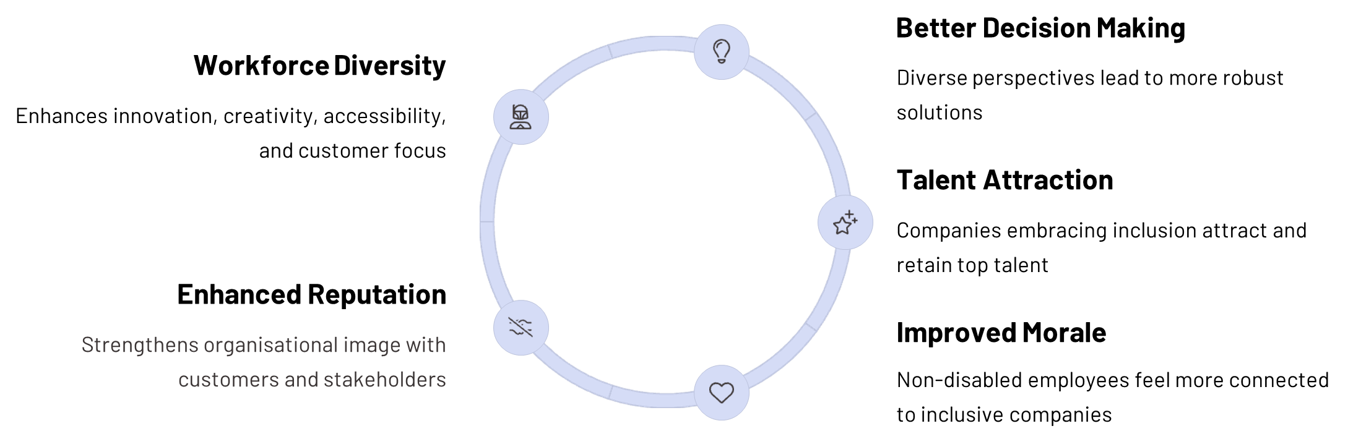
The Value of Inclusive Employment

Slide 20
Understanding Autism Spectrum Disorder
Definition
Prevalence
"A complex developmental condition involving persistent challenges with social communication, restricted interests and repetitive behaviour" (American Psychiatric Association, 2013).
The World Health Organization estimates that approximately one in 100 children worldwide has ASD. A systematic review of 66 population studies refined this to 0.77%, or roughly one child in 130.
Diagnostic Trends
The upward trend reported over recent decades is driven mainly by broader diagnostic criteria and increased societal awareness rather than a true increase in prevalence.

Slide 21
Key Characteristics of Autism
Spectrum of Abilities
Early Signs and Diagnosis
Intellectual Abilities
Autistic people show a wide range of abilities and support needs: some live independently, while others need lifelong care. Autism can limit educational and job opportunities, so social attitudes and formal services strongly shape quality of life.
Although signs may appear in early childhood, diagnosis is often delayed. Many autistic individuals experience additional conditions such as epilepsy, anxiety, depression, ADHD, sleep problems, or self-injury.
Intellectual abilities span from profound impairment to exceptionally high levels. With early, evidence-based support, communication, social skills and quality of life can greatly improve.

Slide 22




Challenges for Autistic Individuals
Communication Barriers
Difficulties with verbal and non-verbal communication
Social Expectations
Challenges navigating unwritten social rules
Sensory Processing
Sensitivity to sounds, lights, textures, and environments
Adaptation to Change
Preference for routine and predictability
Insufficient provider knowledge and fragmented systems leave many without the care and protections to which they are entitled, leading to higher unmet health needs and vulnerability to chronic illness, violence and abuse.

Slide 23
Autism in the tourism and hospitality workplace
Research shows that when tasks and settings are well structured (clear role descriptions, reduced sensory load, and on-site job coaching), employment and retention rates are high.
Despite these good practices, autistic adults remain under-represented in the hospitality sector due to sensory overload, unpredictable shifts, and limited managerial training.
80%
28%
Unemployment Rate
Revenue Increase
Estimated global unemployment rate for adults on the autism spectrum
Average higher revenue for organisations employing neurodivergent personnel
37-46%
Overqualification
Percentage of autistic employees reporting they were overqualified for their roles

Slide 24




Strengths of Autistic Employees
Attention to Detail
Reliability
Exceptional ability to notice patterns and inconsistencies that others might miss.
Strong adherence to schedules and procedures, with high consistency in task performance.
Creative Problem-Solving
Ethical Advantage
More likely to speak up about workplace problems or unethical practices, helping organisations identify and address issues quickly.
Unique perspectives that can lead to innovative solutions to workplace challenges.

Slide 25
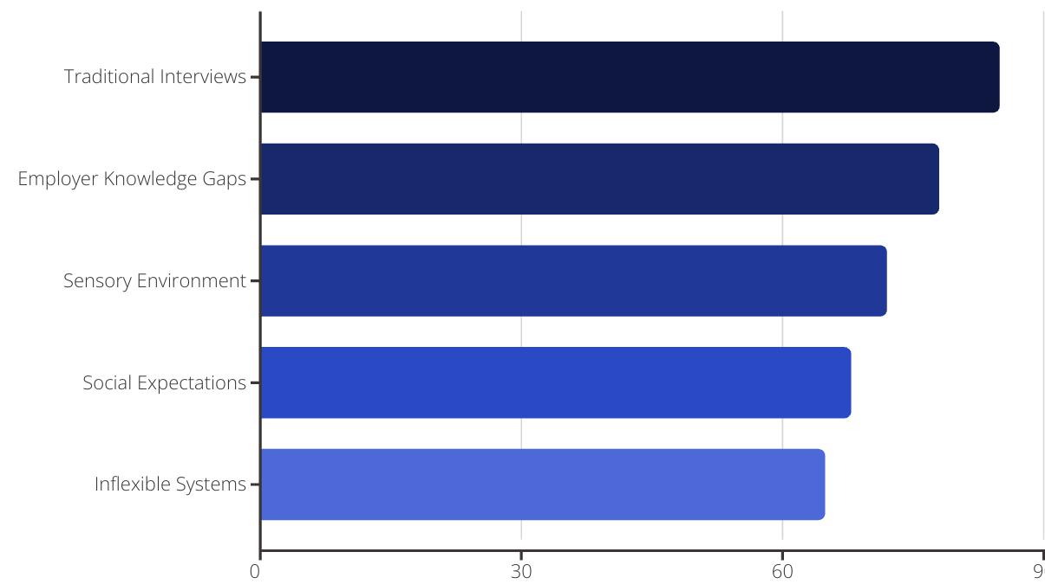
Barriers to Employment for Autistic Individuals
Conventional HR practices—especially unstructured, face-to-face interviews—frequently penalise autistic applicants.
Experimental evidence shows that when recruiters view recorded interviews, autistic candidates who are just as qualified as neurotypical peers are rated markedly less hireable because of atypical eye contact, body language, and vocal inflection.

Slide 26




The Employment Cycle for Autistic Staff
Recruitment
Adapted interview processes, clear job descriptions, skills-based assessment
During onboarding, a written day-by-day schedule, a trained supervisor and sensory-friendly workspaces cut first-week attrition and speed skill acquisition. A 12-month follow-up of autistic adults in a supported-employment program found that all participants retained their jobs for the full year, indicating that structured routines, on-site coaching and low-cost environmental tweaks can secure long-term job stability.
Onboarding
Written schedules, trained supervisors, sensory-friendly workspaces
Development
Mentorship, coaching, clear advancement paths
Retention
Ongoing support, wellbeing focus, accommodations

Slide 27
Creating Supportive Work Environments
Physical Adaptations
Quiet spaces for breaks, reduced sensory stimulation in work areas, clear signage and visual supports, and consistent workspace organisation.
Communication Supports
Written instructions, visual schedules, direct and clear communication, regular check-ins, and structured feedback sessions.
Social Supports
Mentorship programs, clear social expectations, autism awareness training for all staff, and designated support contacts.
Workflow Adaptations
Clear routines, advance notice of changes, task breakdown, and strengths-based job matching.

Slide 28

Key Takeaways and Next Steps
1
Strategic Value
Inclusive employment of autistic individuals is not charity but a strategic business advantage that enhances innovation, customer service, and team performance.
2
Tailored Approach
Successful inclusion requires adapting recruitment, onboarding, and workplace practices to accommodate different communication styles and sensory needs.
3
Ongoing Support
Mentorship, clear communication, and structured environments are crucial for long-term retention and career development of autistic staff.
4
CSR Integration
Embedding autism inclusion within broader CSR frameworks creates sustainable, measurable impact that benefits businesses, individuals, and communities.

Slide 29
Funded by the European Union. Views and opinions expressed are however those of the author(s) only and do not necessarily reflect those of the European Union or the European Education and Culture Executive Agency (EACEA). Neither the European Union nor EACEA can be held responsible for them.
THANK YOU
Project Number 2023-1-IT01-KA220-VET-000152721

